Slide 1
INTRODUCTION OF COMPUTER NETWORKS
DR.ANBARASI
Assistant Professor
LRG Govt arts college for women
Tirupur

Slide 2
Uses of Computer Networks
Business Applications
Home applications
Mobile users
Social users

Slide 3
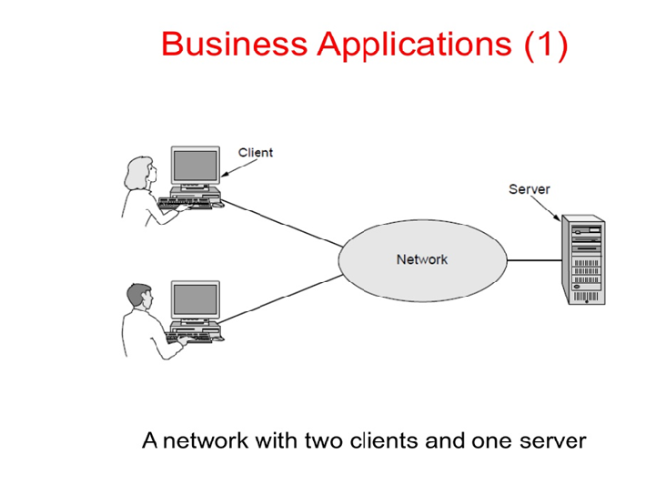

Slide 4
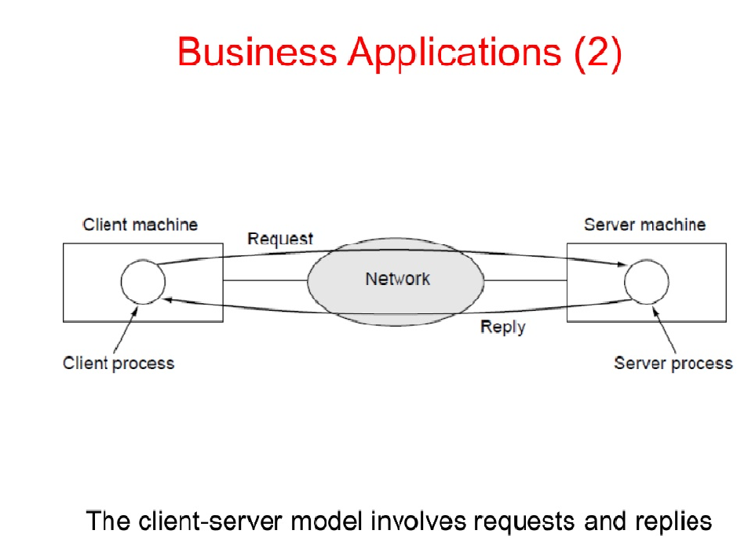

Slide 5
Home Applications
Access to remote Information
Peer to Peer Communication
Interactive Entertainment
Electronic Commerce

Slide 6
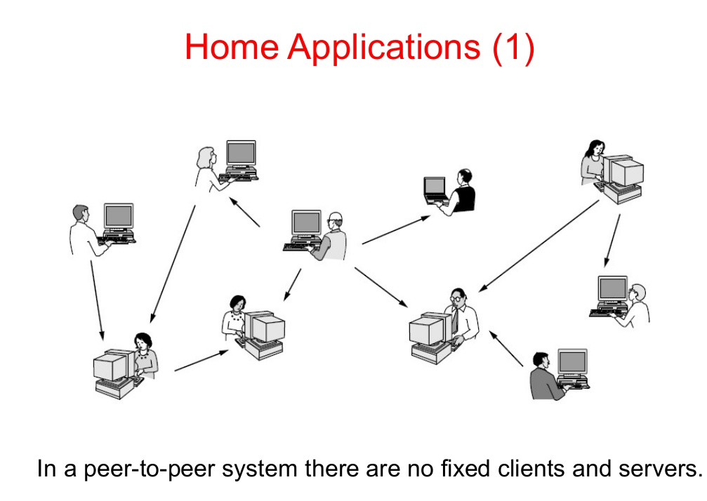

Slide 7
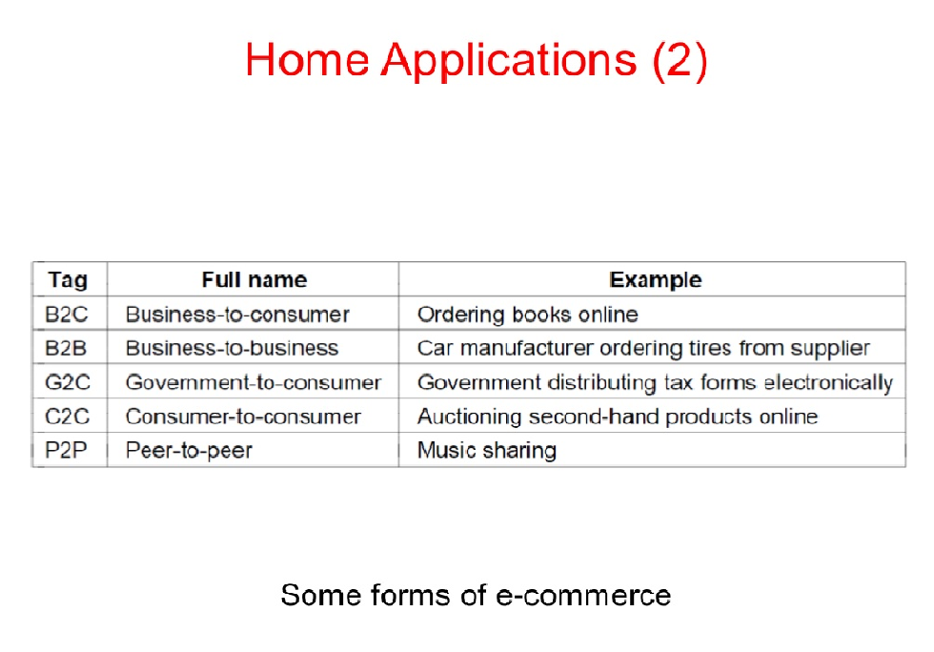

Slide 8
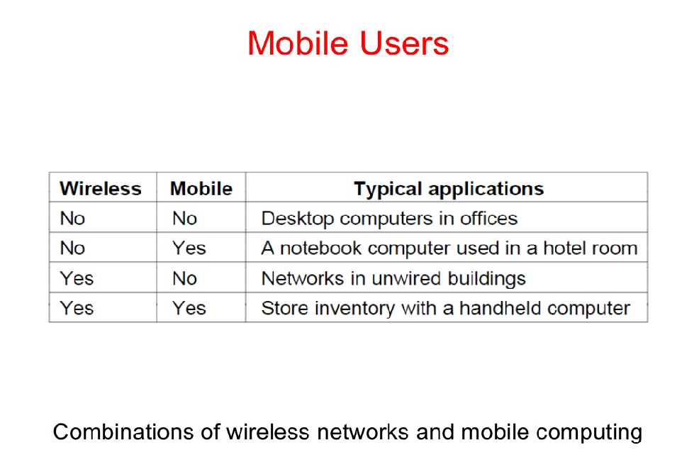

Slide 9
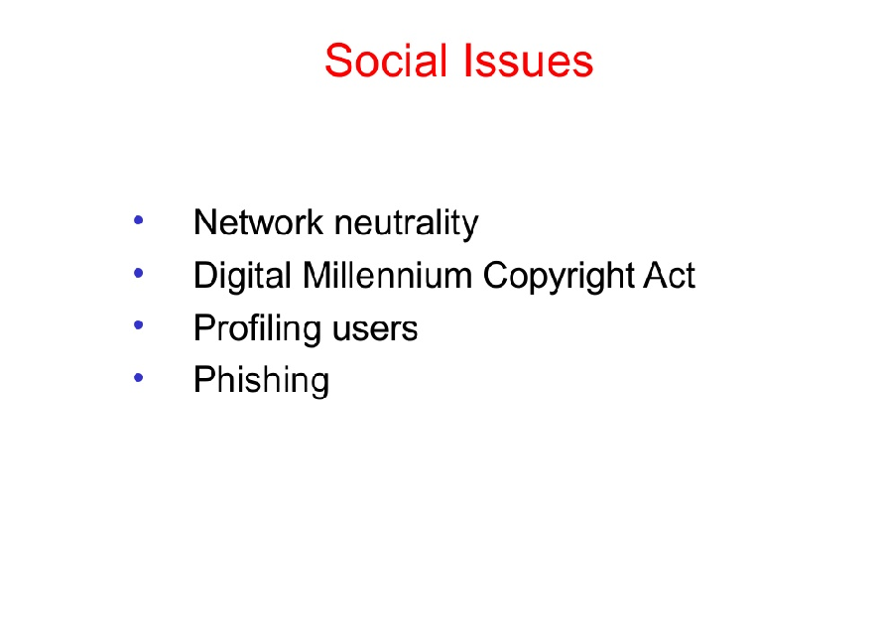

Slide 10
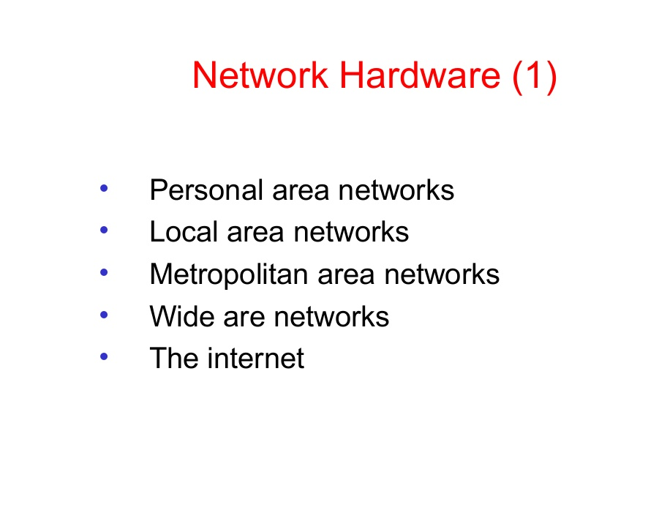

Slide 11
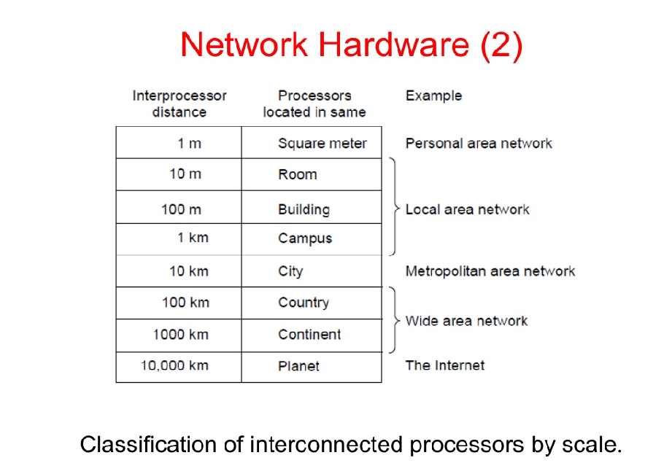

Slide 12
Network Hardware
Types of transmission
Broadcast links or multicast
Point to point links or unicast

Slide 13
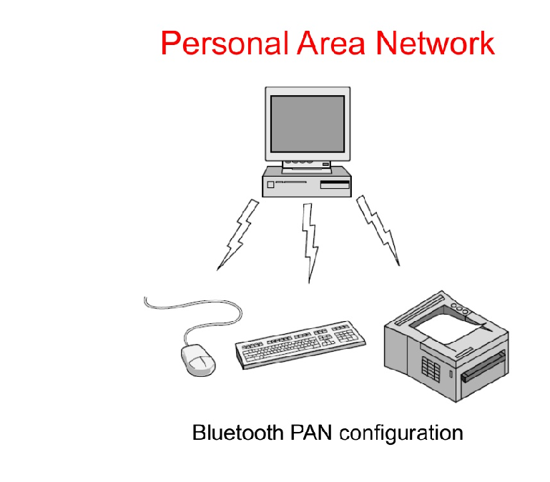

Slide 14
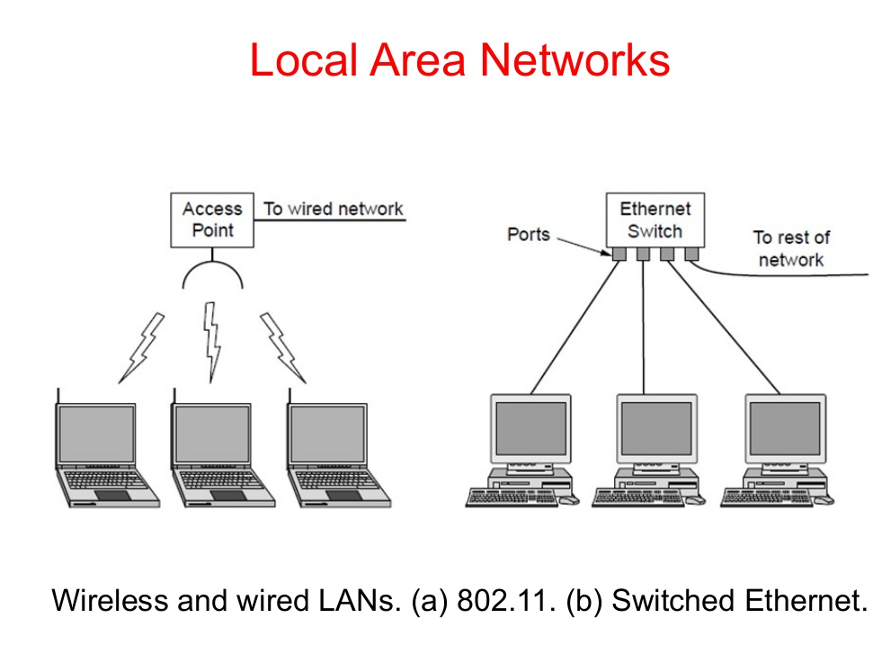

Slide 15
LAN Topologies(Physical)
Bus
Star
Ring
Tree
Hybrid

Slide 16
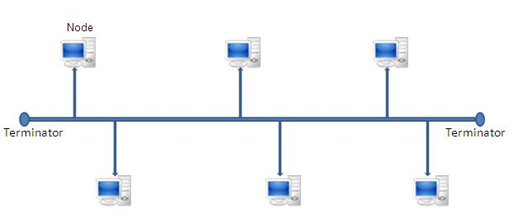
Bus topology
Bus topology is the kind of network topology every device on the network is connected to a main cable line. Data is transmitted in a single router. We cannot transmit data in both ways.

Slide 17
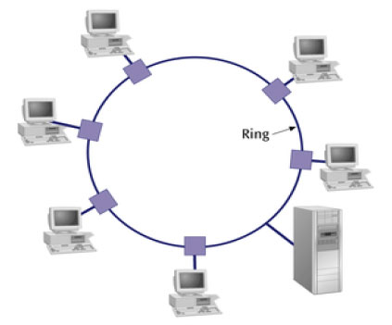
Ring Topology
Ring Topology is a type of topology in which every computer is connected to another computer on each side, with the last computer being connected to the first, thus forming a ring shape. This topology allows for each computer to have exactly two neighboring computers.

Slide 18
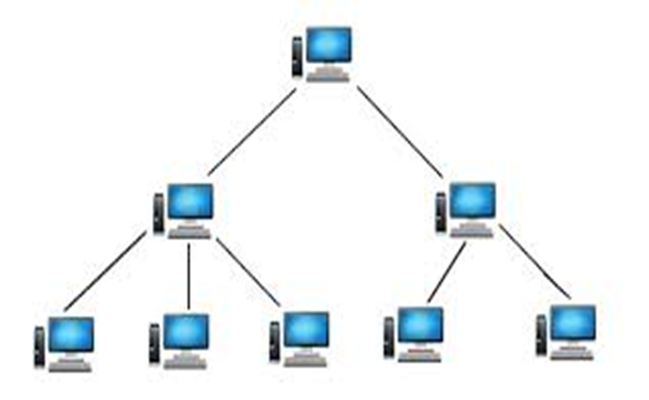
Tree Topology
Tree topology is the kind of topology in which the nodes are connected in a hierarchical manner, with all the nodes being connected to the topmost node or root node.it. Tree topology has at least three levels of hierarchy.

Slide 19
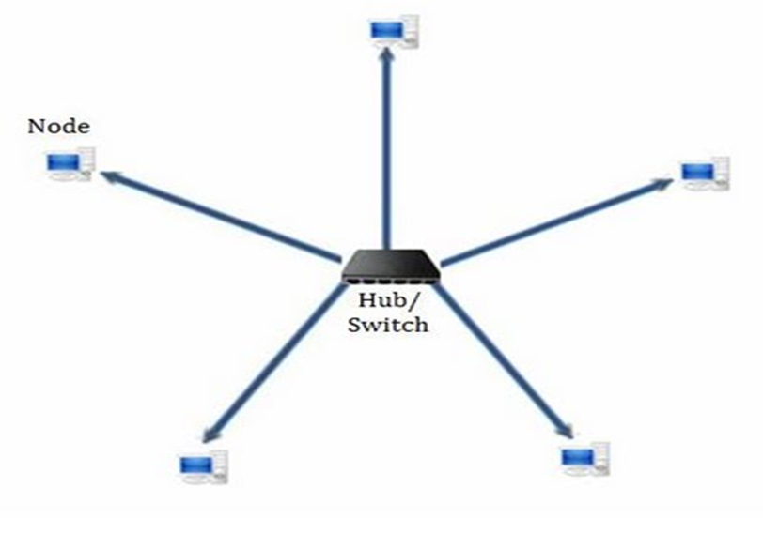
Star Topology
Star Topology is the kind of network topology in which all the nodes are connected via cables to a single node called hub, which is the central node.

Slide 20
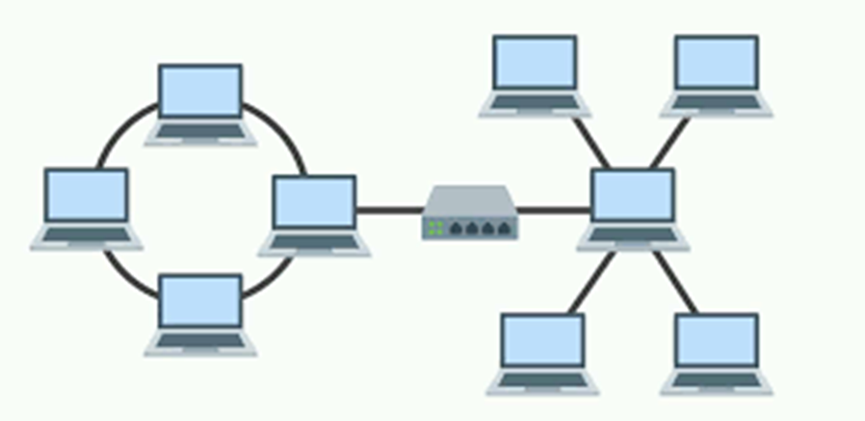
Hybrid
Hybrid Topology It is two different types of topologies which is a mixture of two or more topologies.

Slide 21
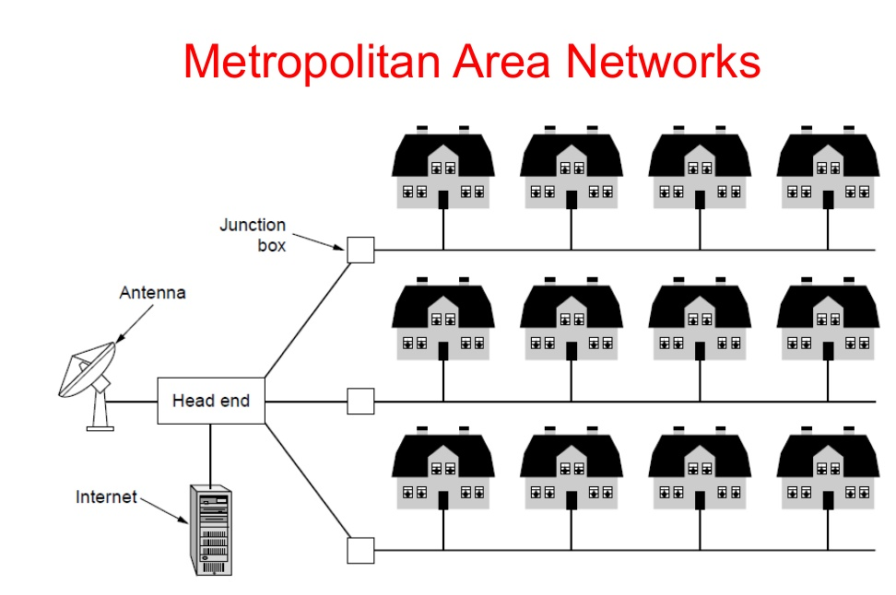

Slide 23
WAN
Host
Subnet
Transmission lines
Switching Elements
Store and forward or packet switched
Router

Slide 24
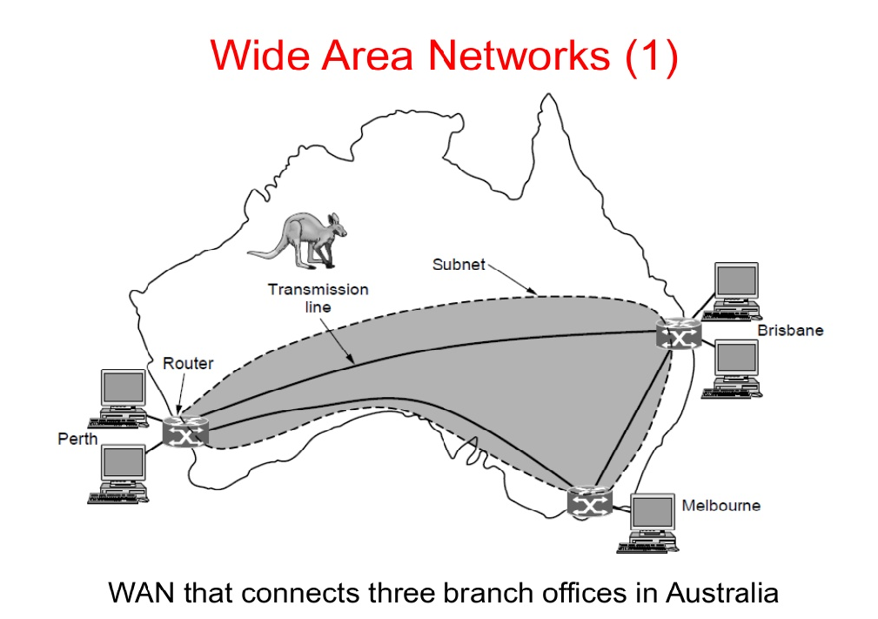

Slide 25
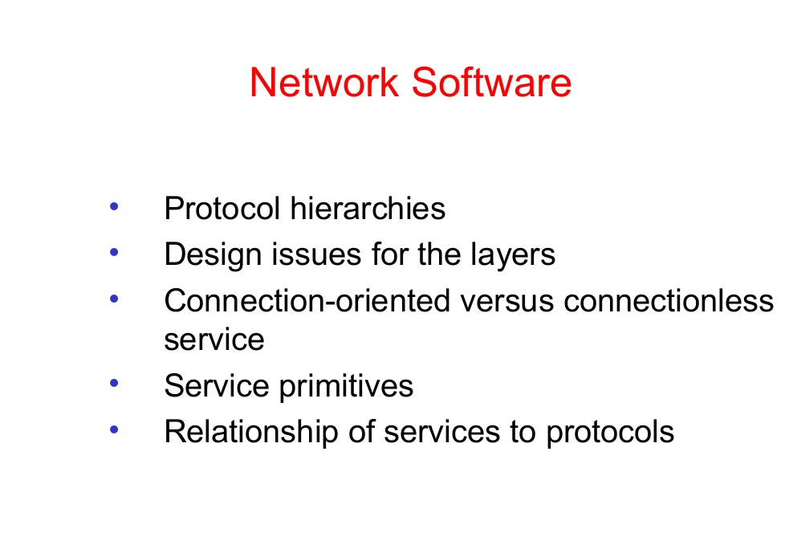

Slide 26
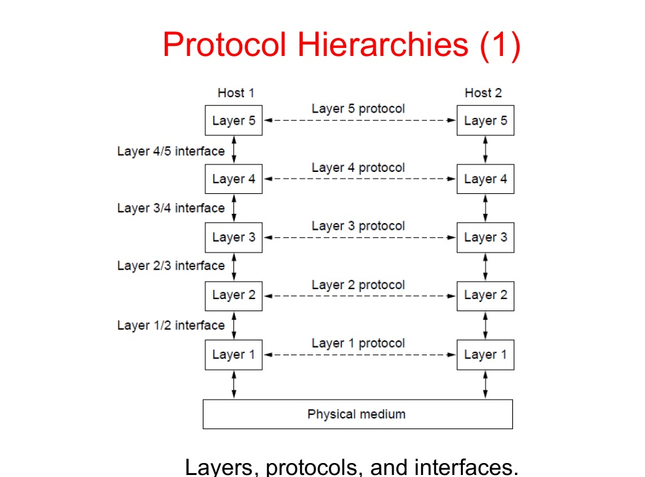

Slide 27
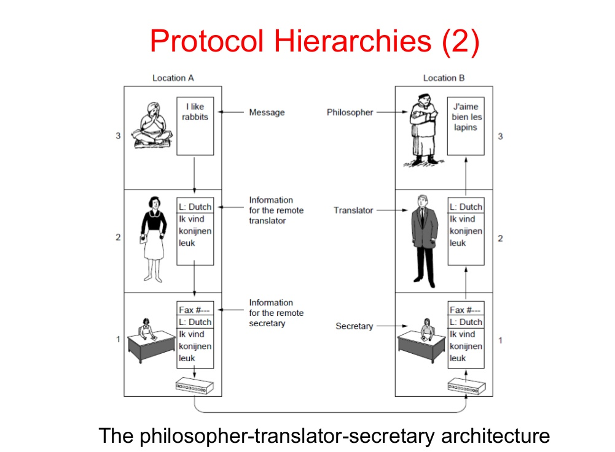

Slide 28
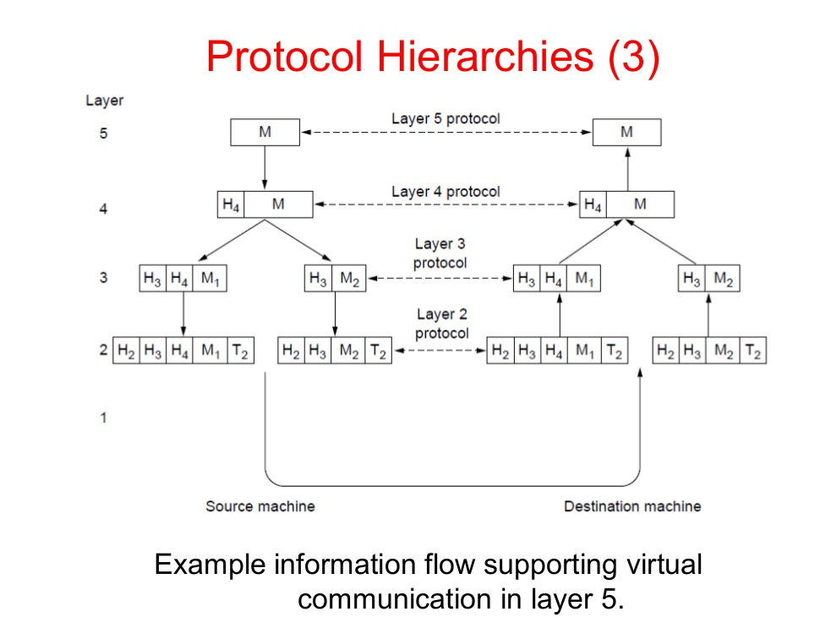

Slide 29
Design issues for the layers
Error Control
Flow Control
Multiplexing
Demultiplexing

Slide 30
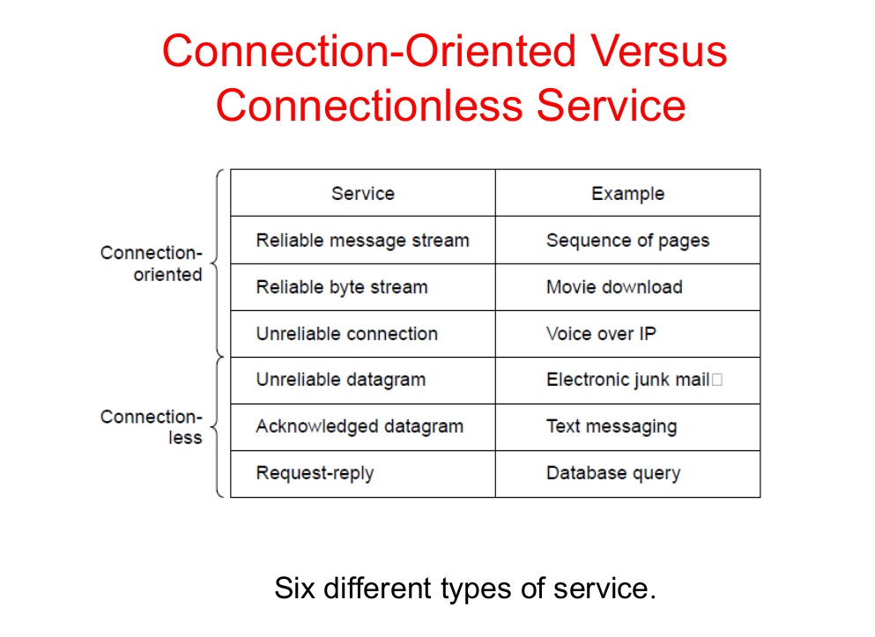

Slide 31
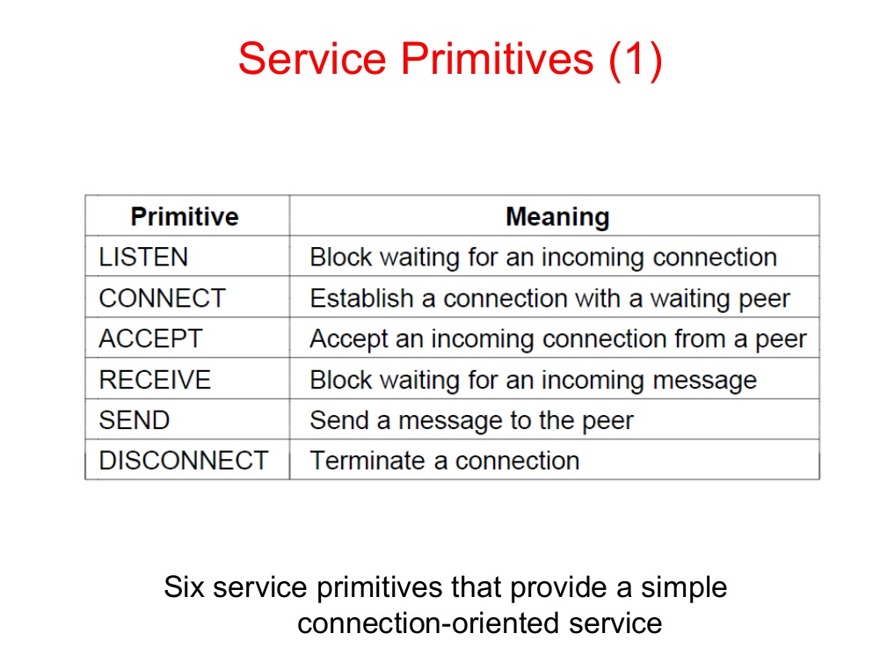

Slide 32
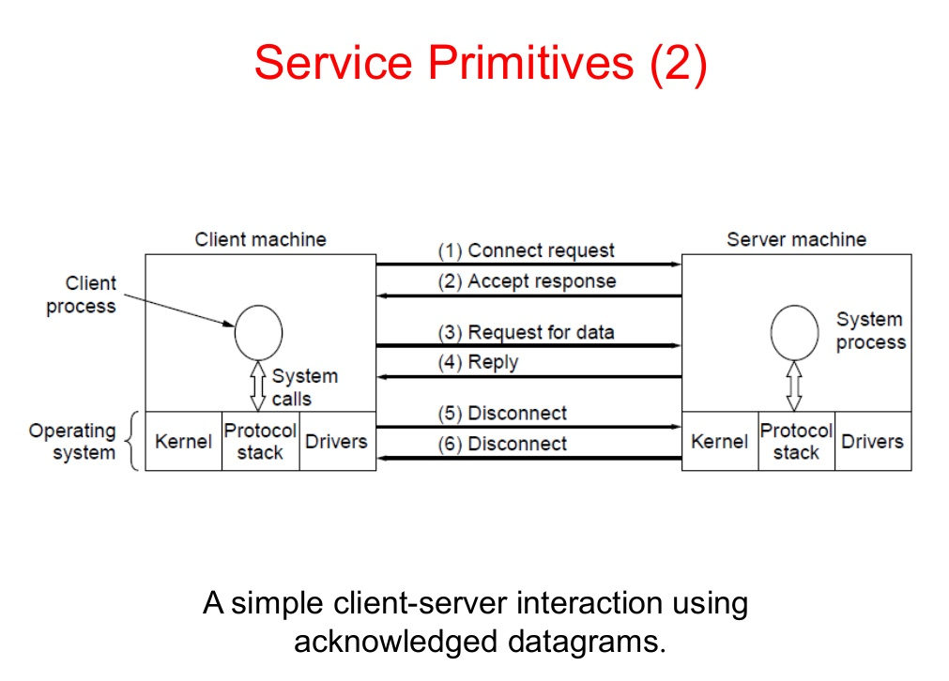

Slide 33
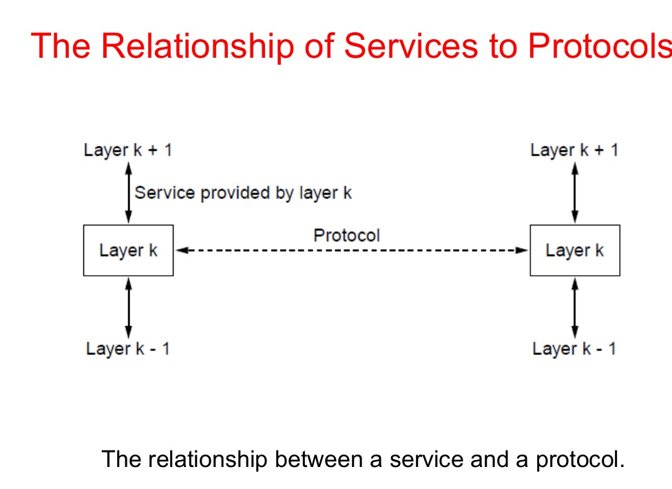

Slide 34
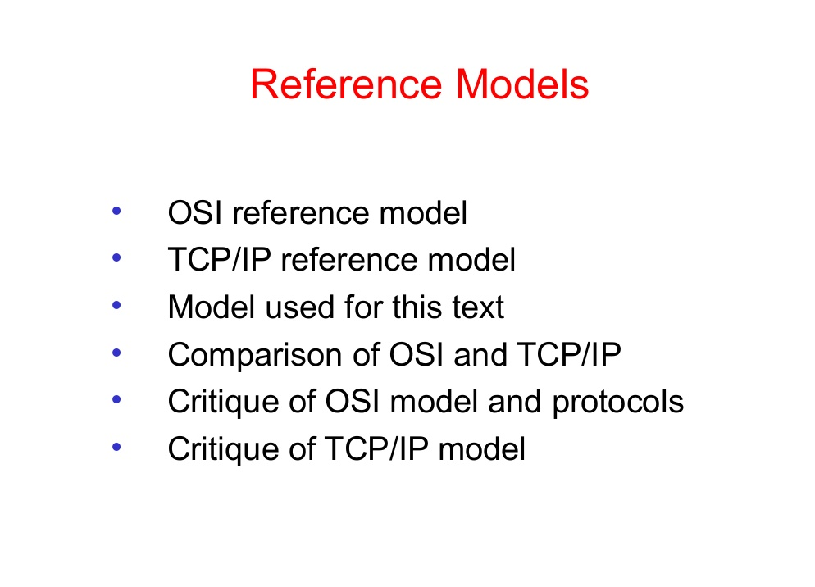

Slide 35
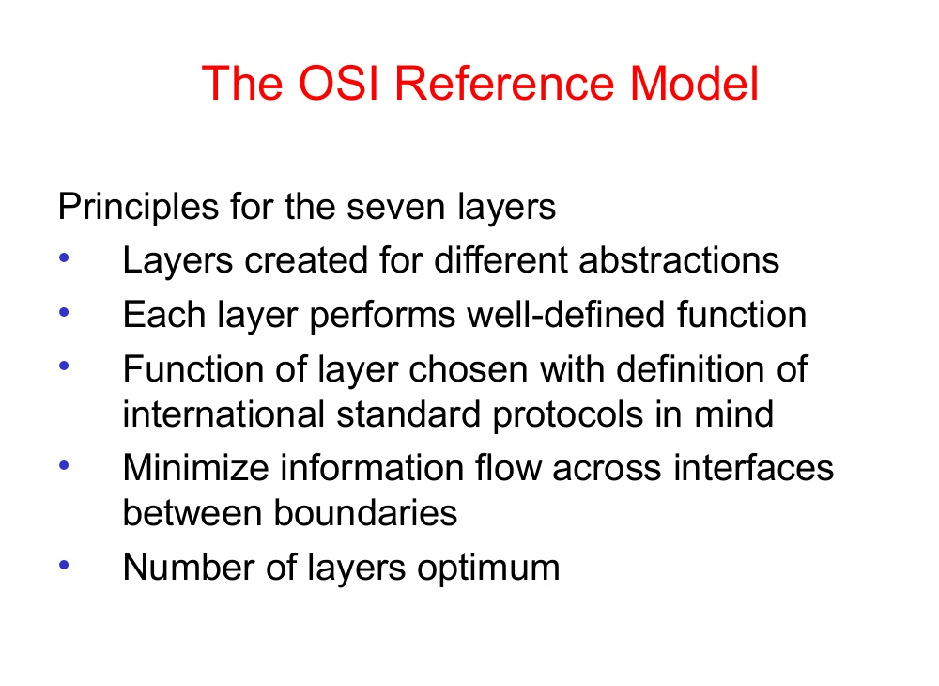

Slide 36
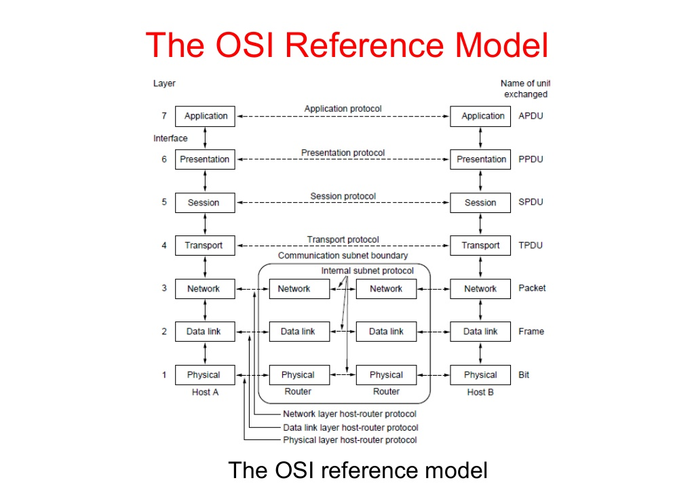

Slide 37
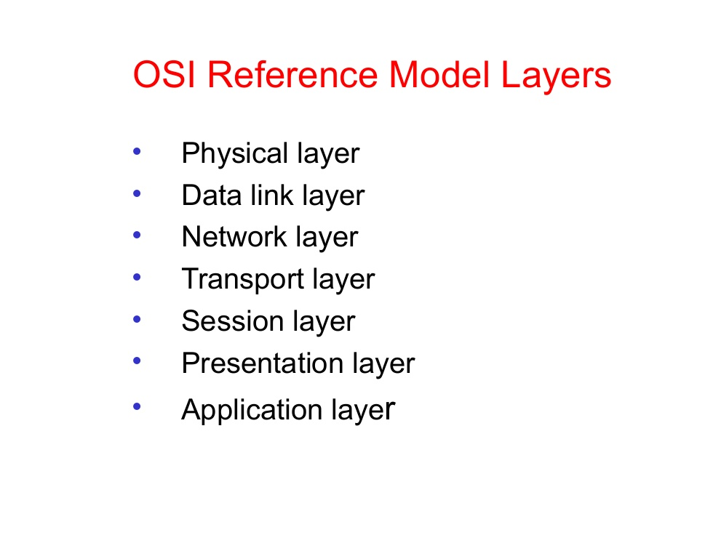

Slide 38
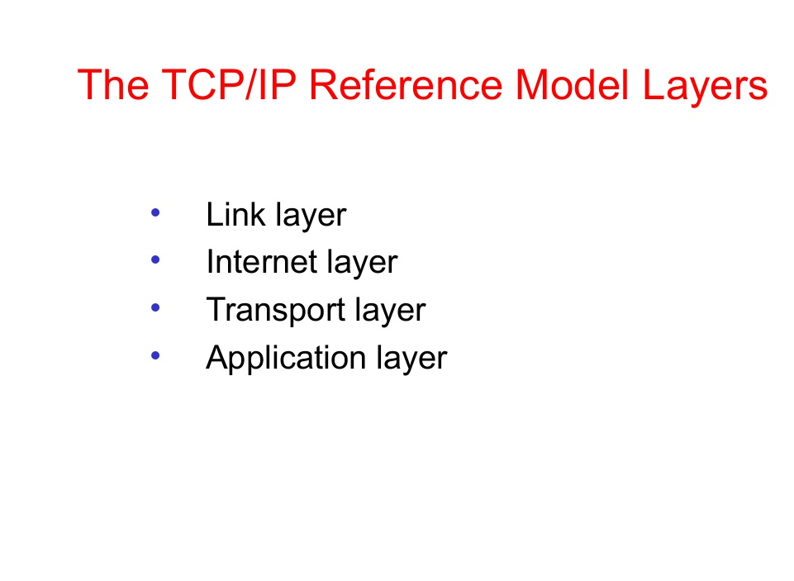

Slide 39
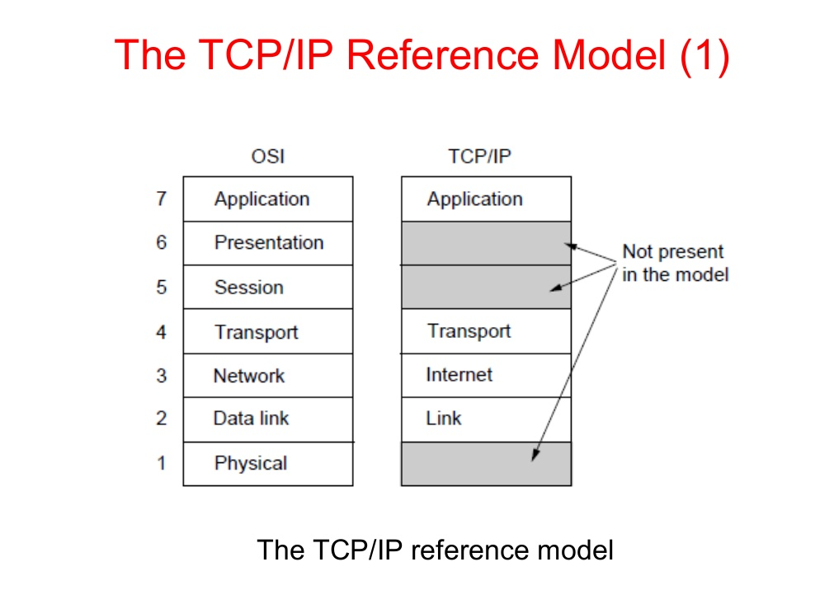

Slide 40
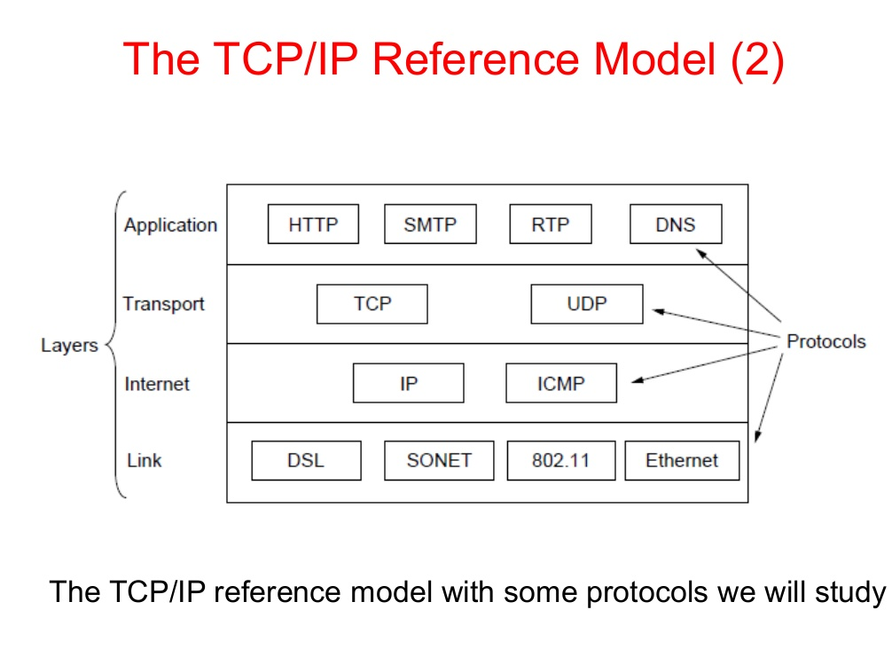

Slide 41
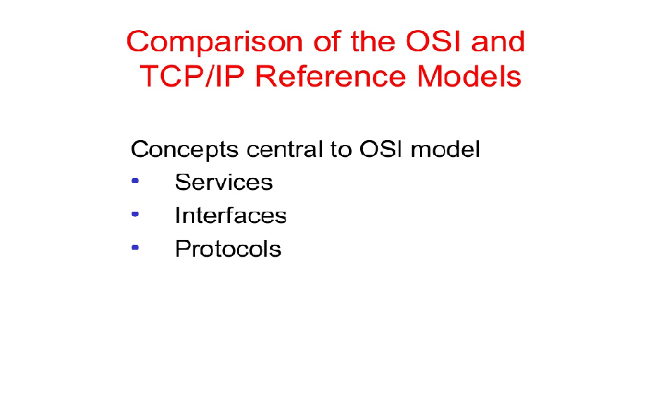

Slide 42
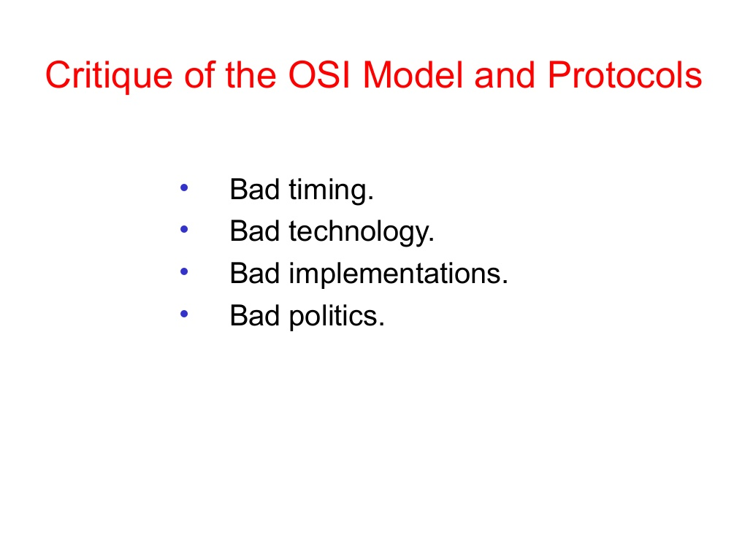

Slide 43
